Slide 1
CHEMICAL SCIENCES
DIVISION
LABORATORY SAFETY
http://ipc.iisc.ernet.in/~ashoka/safety/safety.pptx
Notes:
Several faculty members from the division have contributed to this document.
Someone has coined the term copy lefted to indicate “open source” media. This document is copylefted. It has been put together from a large no. of hits generated by a Google search on Laboratory Safety. One might say this document is copy-centred. Every which way you turn, it is copied!
But when it comes to Laboratory safety, you have to learn from the experience of others.

Slide 2
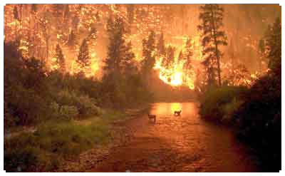
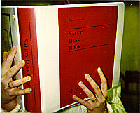
Laboratory Safety
Notes:
It is a little too late to read the manual of the fire extinguisher when the lab is on fire Read it in advance!

Slide 3
YOUR RESPONSIBILITY
Safety in the lab is your responsibility. It is to your advantage to learn and practice safe laboratory practices.
Whenever necessary, you will be given laboratory safety instruction. You should always read written safety materials given in published papers before
carrying out a procedure.
3/30/2012
3

Slide 4
SAFETY QUIZ
Some laboratories classes insist on satisfactory
completion of a safety quiz. See for example
http://daphne.palomar.edu/safetyquiz/safetyquiz.htm
If you do not pass this quiz with at least an 80% proficiency you will not be allowed to work in the laboratory.
3/30/2012
4

Slide 5
With the help of the Safety Committee….
Promote safety awareness.
Ensure and maintain a safe and healthy environment in the laboratory.
Teach / practice “safe work” practices.
3/30/2012
5

Slide 6
SAFETY PROGRAM
Training a wholesome safety program
STORAGE OF HAZARDOUS MATERIALS
(the chemicals we use)
Practice safe techniques in
synthesis and handling
SAFE DISPOSAL OF HAZARDOUS WASTES
DEVISING EMERGENCY PROCEDURES
(first aid, fire, earthquake, building evacuation)
3/30/2012
6

Slide 7
Danger!
Real and Imagined
Danger is there everywhere..
Where are you safer?
  On a trip to Mysore and back by train / on the NICE road ?
  Working in the laboratory ?
  Going to Yeshwantapur by a two wheeler ?
Notes:
One needs to be careful in worrying about safety. (Too much or too little can be bad.).
Too much and then you can be so paranoid that you decide to do only chemistry on a computer.

Slide 8
Sources of Danger
Intrinsic to Chemistry (Unavoidable)
  Chemicals
  Compressed Gas Cylinders
  Liquid Nitrogen Containers
  High Temperature
  Safety from Electrical fires
Notes:
A laboratory is a dangerous place. The slide numbers are shown as links on the slide and indicate types of danger one should be aware of.

Slide 9
Sources of Danger
Unsafe Practices (AVOIDABLE)
  Storage
  Personal protection
  Uncharted Paths & Human error
  Disposal
Notes:
A laboratory is a dangerous place. The slide numbers are shown as links on the slide and indicate types of danger one should be aware of.

Slide 10
Chemicals
Potential Danger
  Explosives
  Flammables
  Poisons, Carcinogens, Irritants Mutagens: CO, C₆H₆, etc..
Notes:
All chemicals should be regarded as potentially dangerous
- Before working with chemicals with which you are unfamiliar, consult the MSDS and familiarize yourself with the properties and the hazards associated with the use of that chemical
You should become aware of the following possible hazards: toxicity (often quoted in terms of the threshold limit value, TLV, given as PPM of air by volume, which should not be exceeded); PEL (OSHA Permissible Exposure Limit)
Flammability; ignition temperature; and, carcinogenic properties;
You should also know the recommended method of disposal for the chemical.

Slide 11
Chemicals
Proper Response
  Appropriate Storage
  Careful Transport
  Minimum Usage
  Correct Disposal
Notes:
All chemicals should be regarded as potentially dangerous
- Before working with chemicals with which you are unfamiliar, consult the MSDS and familiarize yourself with the properties and the hazards associated with the use of that chemical
You should become aware of the following possible hazards: toxicity (often quoted in terms of the threshold limit value, TLV, given as PPM of air by volume, which should not be exceeded); PEL (OSHA Permissible Exposure Limit)
Flammability; ignition temperature; and, carcinogenic properties;
You should also know the recommended method of disposal for the chemical.

Slide 12
Materials Safety Data Sheets
MSDS
MSDS Hyperglossary Hyperglossary
MSDS Demystifier Demystifier
Hypoxia Your body isn't getting oxygen, you will die.
  If working in an enclosed space or with an asphyxiant. Move to a well-ventilated area if you become light-headed, weak or disoriented.
An example of a chemical causing it is CO. Be sure you understand the dangers of carbon monoxide in the home and workplace. This nasty, invisible, odorless, colorless, gaseous poison can cause hypoxia and death!
Camphor
3/30/2012
12

Slide 13
MATERIAL SAFETY DATA SHEETS
MSDS
A Material Safety Data Sheet (MSDS) is a multipage (for each chemical, several pages are there) document that contains the following information about a chemical.
Flammability
Toxicity
Exposure Risks (contact, inhalation, ingestion)
Reactivity and Fire Hazards
Mixing Hazards (with other chemicals)
Emergency First Aid Procedures
Spill Handling Procedures
Disposal Procedures

Slide 14
SOME SPECIAL MSDS TERMS
LD₅₀ Lethal Dose, 50% Mortality mg/kg
TLV Threshold Limit Value mg/m³ (ppm)
PEL Permissible Exposure Limit mg/m³ (ppm)
STEL Short-Term Exposure Limit mg/m³ (ppm)
Carcinogen a substance shown to cause cancer
Teratogen a substance shown to cause birth defects
See the Laboratory Safety section of the textbook for a complete discussion of these terms.

Slide 15
Chemicals
  Read the label
  Review hazards of chemicals before starting an experiment. Secure hoses/tubing
For more comprehensive listing and advice regarding chemical safety, please refer to the Ohio State University’s plan
–http://chemistry.osu.edu/files/ehs/genericchp.pdf
Notes:
In most cases, the label on the bottle is sufficiently good. In any case, the label in a chemical container is a must read. An example is given.
Conversely, avoid using empty containers to store other chemicals. In any case, storing chemicals in empty containers without removing the label is bad.

Slide 16
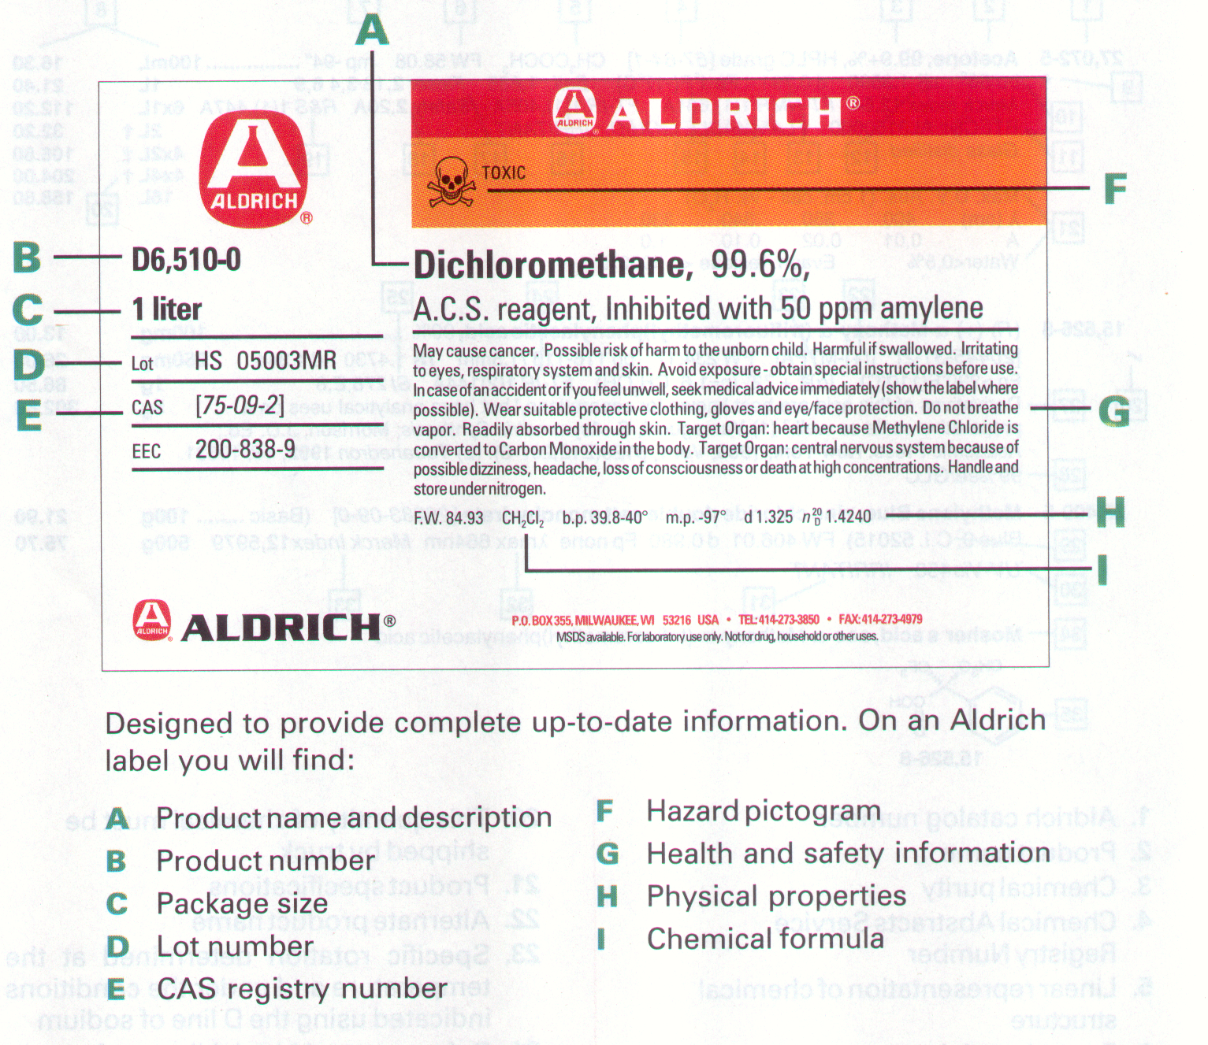
Notes:
This is the label of dichloromethane.
The next slide explains the small text.

Slide 17
Dichloromethane, 99.6%
A.C.S. reagent, Inhibited with 50 ppm amylene
May cause cancer. Possible risk of harm to the unborn child. Harmful if swallowed. Irritating to eyes, respiratory system and skin. Avoid exposure - obtain special instructions before use. In case of an accident or if you feel unwell, seek medical advice immediately (show the label where possible). Wear suitable protective clothing, gloves and eye/face protection.
Do not breathe vapor. Readily absorbed through skin.
Target Organ: heart because Methylene Chloride is converted to Carbon Monoxide in the body.
Target Organ: central nervous system because of possible dizziness, headache, loss of consciousness or death at high concentrations.
Handle and store under nitrogen.
Notes:
I use this example to merely illustrate how much we do not know about common solvents.
May cause cancer. Possible risk of harm to the unborn child. Harmful if swallowed. Irritating to eyes, respiratory system and skin. Avoid exposure - obtain special instructions before use. In case of an accident or if you feel unwell, seek medical advice immediately (show the label where possible). Wear suitable protective clothing, gloves and eye/face protection.
Do not breathe vapor. Readily absorbed through skin.
Target Organ: heart because Methylene Chloride is converted to Carbon Monoxide in the body.
Target Organ: central nervous system because of possible dizziness, headache, loss of consciousness or death at high concentrations.
Handle and store under nitrogen.

Slide 18
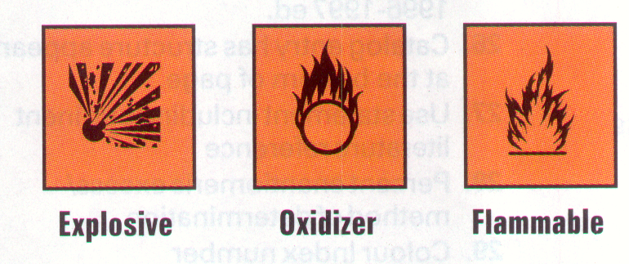
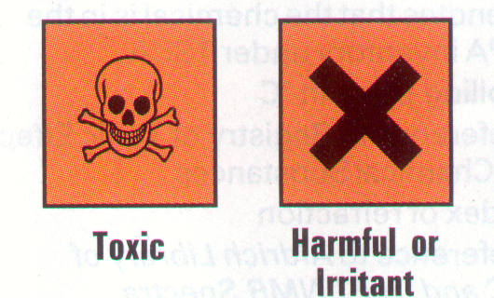
Notes:
If you find any one of these signs, you should read the label more carefully.

Slide 19
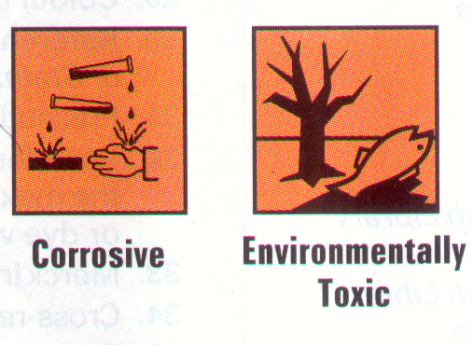
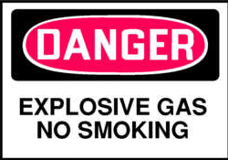
Notes:
Post these signs in the hood/lab if you are using such chemicals regularly.

Slide 20
Chemical Burns
Hydrofluoric Acid Burn from Trifluoracetic Acid
A laboratory worker picked up a container of trifluoroacetic acid with her ungloved hand to move it. She did not notice that there was a small amount of residue on the glass. Several hours later, she experienced pain in the palm of her hand and thumb. There was a serious burn that required skin grafting. She was not aware that this type of burn could result from handling trifluoracetic acid.
Trifluoracetic acid can form hydrofluoric acid upon contact with moisture. Hydrofluoric acid can cause deep burns that may not be painful for hours.
Notes:
Some chemicals are unique. They might react to generate another dangerous chemical. If your lab uses any of these then you should be aware of the danger.

Slide 21
What should we do ?
  -Know the hazards of the chemicals involved before handling them.
  -Always assume containers are likely to be contaminated on the outside and wear appropriate gloves when handling chemical containers.
  -Keep appropriate first aid: in this case, hydrofluoric acid burn kit in the laboratory when working with hydrofluoric acid or trifluoracetic acid.

Slide 22
POTENTIAL SHOCK-SENSITIVE CHEMICALS
Ammonium nitrate
Ammonium perchlorate
Calcium nitrate
Copper Acetylide
Cyanuric triazide
Ammonium picrate
Trinitroanisole
Trinitrobenzene
Trinitroanything ?
Notes:
The next three frames introduce chemicals that can explode:
(a) by shock
(b) by forming peroxides which then react with organics to explode
(c) On combining with a particular chemical.

Slide 23
POTENTIAL PEROXIDE-FORMING CHEMICALS
Acetal Ether (Glyme)
Cyclohexene
Decahydronaphthalene
Tetrahydronaphthalene
Isopropyl Ether
Diethyl Ether
Tetrahydrofuran
All ethers?!
Diethylene Glycol
Sodium Amide
Methyl Acetylene
Dicyclopentadiene
Notes:
Please note that this list is not exhaustive, there are several chemicals used in an inorganic / organometallic laboratory.

Slide 24
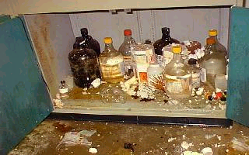
Incompatible Chemicals
Ω
Notes:
Nitric acid reacts violently with most organics resulting in heat, gas or fire. In a sealed container, the pressure would increase due to the expanding gas. Never mix nitric acid with organic materials (especially in a sealed container) unless you are carrying out a thoroughly investigated reaction. Do not store nitric acid in the same cabinet as organic solvents or organic acids such as acetic acid.

Slide 25
Toxic Chemicals
LEVELS
  Phenol (irritant)
  Phosgene, mercury (poison)
  1-Naphthylamine, benzidine, dimethyl sulfate (carcinogens)
  arsenic compounds, (Mutagens)
Notes:
Chemicals can affect your life/health in many ways.
Substances such as carcinogens, mutagens, irritants, or poisonous gases, liquids, and solids which are irritating to or affect the health of humans need special care in handling and storage.

Slide 26
Poisons...
Mercury Compounds
      1997 June 10 The News York Times HANOVER, N.H., -
      A Dartmouth College chemistry professor Karen E. Wetterhahn, 48, has died from exposure to a rare form of mercury, first synthesized more than 130 years ago. Dimethylmercury Skin Exposure Fatality
Notes:
The links above illustrate what has happened elsewhere. This is not ancient history.

Slide 27
Carcinogens
Benzene
CCl₄
Thiourea
Saccharin
Methyl Iodide
Metronidazole
Most Dyes..
Lists are available from Unversity of Bath
Notes:
Some of these chemicals are “apparently” harmless.

Slide 28
Mutagens and Teratogens……….
Huge list…
Priority chemicals are given here local list
Notes:
Check on the link to see a list.

Slide 29
Storage of Chemicals
The principle concern is to achieve / maximize STUDENT safety
Proper storage will account for
  chemical compatibility, (Check Chart) Ω
  spill control
  fire / explosion control, (Not yet)
  Temperature
  provide a "user friendly" system (inventory)
Notes:
This section deals with storage of chemicals. Most labs use approximately 30% of the chemicals they have.
% chemicals in active use = 100 – [(5+m) xn]
Where the age of laboratory in years is n and the no. of times they have shifted is m.

Slide 30
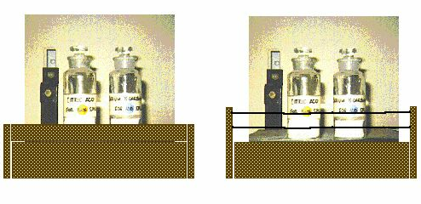
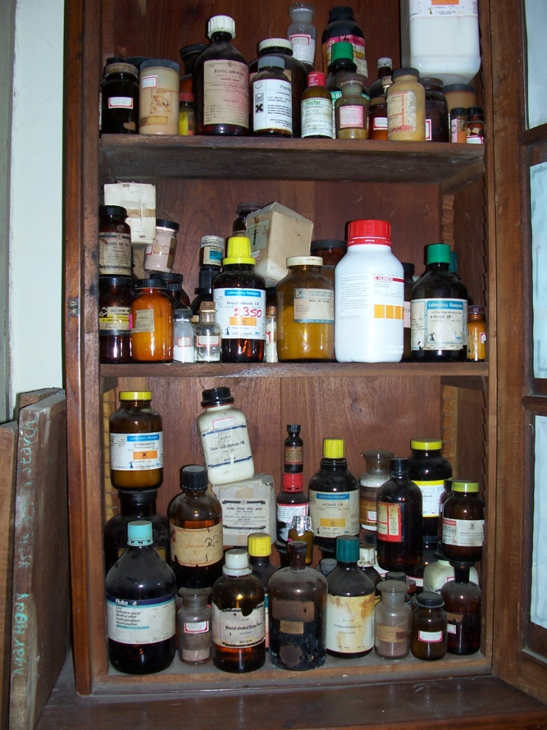
Storing Chemicals
C
Wrong way to store
Chemicals.
Notice how the bottles are stacked.
Notes:
Make sure the chemical is kept in a safe place. Very often, glassware and chemicals are kept in the edge of the table. Avoid it.

Slide 31
STORAGE CABINETS
Secondary containment is also a requirement for
the storage of volatile liquids.
The ventilated cabinets used to store
volatile reagents must have a chamber
at the bottom which can contain
the entire contents of the
cabinet if the reagents
should spill.
These cabinets will also
contain a fire and prevent
serious fire damage.
FLAMMABLE
Notes:
Special storage reagents are present for solvents.

Slide 32
Flammable Liquids Storage & Handling
Flammable liquids are stored and used in drums away from ignition sources. (DRUMS Not to be used as a stand)
Bulk quantities of flammable liquids (within permissible quantities) are stored in properly labeled storage cabinets, preferably away from the lab.

Slide 33
Flammable Liquids Storage & Handling
  Flammable liquids should be handled in a fume hood to prevent accumulation of vapors.
  Heat guns and other equipment capable of igniting flammable vapors should not be used to heat flammable solvents or liquids.
  Expolsions from solvents
Notes:
Fire/Burn from Heating Flammable Solvent with a Heat Gun (top)
A laboratory worker was using a heat gun to heat approximately 0.5 liters of heptane in a Pyrex beaker by hand over an open bench. A splash of heptane came in contact with the elements of the heat gun, igniting the heptane and causing him to toss the beaker away from him. The sleeve of the worker's shirt caught fire. The flaming beaker landed on another work surface, spreading the fire to his computer. The worker immediately used a safety shower to put out the fire on his clothing, then used a dry chemical fire extinguisher to put out the other fire.
A full list is given in
/~ashoka/safety/fil.html

Slide 34
CHEMICAL SPILLS
It is your responsibility to clean up any chemicals that you spill.
If necessary, ask for guidance when you don’t know how to clean the spill.
For dil. acids and aqueous solutions, sponges and paper towels.
If there is a major spill of a volatile or hazardous substance, you may have to evacuate the lab.
Notes:
Hg, acids and other corrosives have to be handled correctly.

Slide 35
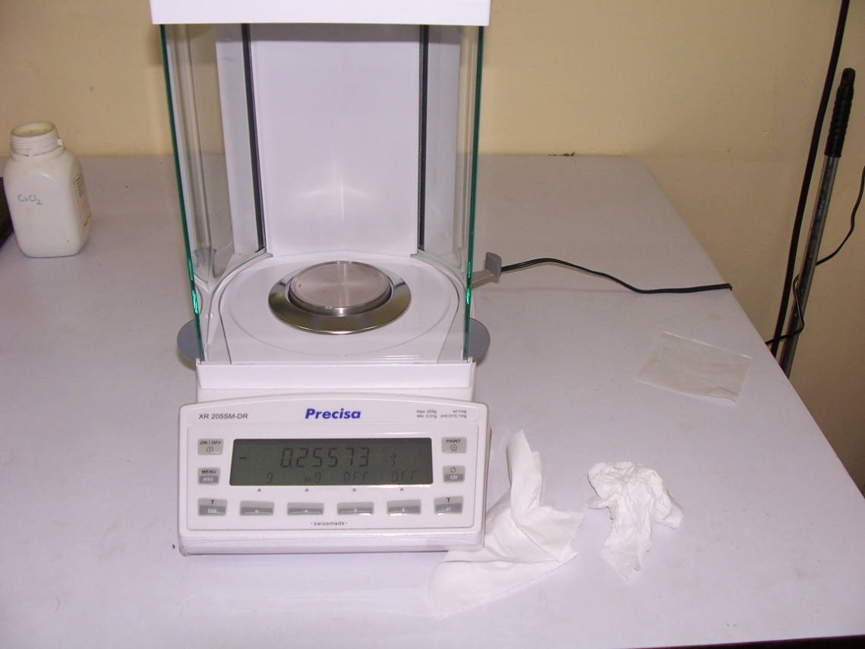
Notice how tissue paper is left lying around near the balance.
Notes:
Balances are places where chemicals are often split – the area should be cleaned up after each user.
Common areas around the spectrometers (IR and UV-vis) are also.

Slide 36
Transport of Chemicals
Gas cylinders:
  Use Trolleys
  Cap it while transporting
Liquid Nitrogen:
Corrosive Chemicals
Notes:
Transport of chemicals need special attention.

Slide 37
SECONDARY CONTAINMENT
Whenever reagents are moved from stores to laboratory, secondary containment is required.
Secondary containment requires that each reagent be placed in an unbreakable container with a lid that will “contain” or hold the contents of the primary (usually glass ) container if it should break.
When reagents are brought from the stockroom to our lab, they are either placed in a trolley with containment chambers, or in special hand-carried polyethylene “buckets”. All of these carriers should have secure lids.
3/30/2012
37

Slide 38
TRANSPORTING CHEMICALS
reagent bottles go inside chambers
top
not to scale
bottle carrier
safety basket
(holds a 5 L bottle)
containment cart
(holds six 500 mL bottles)
(holds various lab supplies)
Notes:
Use a trolley whenever you transport large amounts.

Slide 39
Carrying Chemicals Incorrectly
  A laboratory worker placed unsealed centrifuge tubes filled with phenol-chloroform into a styrofoam centrifuge tube shipping container. The styrofoam broke and the phenol-chloroform splashed onto the worker’s face and dripped down the chest. The worker immediately flushed the area with a water, but still suffered from second-degree burns to the face, chest and abdomen.
  Fortunately, the worker was wearing chemical splash goggles and did not receive burns to the eyes.

Slide 40
What do we learn ?
  - Appropriate eye and face protection helped to minimize the chemical burn.
  -Wear a closed lab coat when working with hazardous materials.
  -Use a plastic centrifuge rack instead of a Styrofoam packing container, particularly when transporting chemicals.
3/30/2012
40

Slide 41
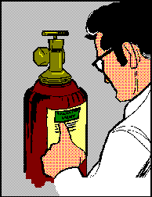
Cylinders
Identification of gases:
Notes:
Gases need special precaution in handling.
All gases are let in to your reaction vessel through a two stage regulator. However, if the regulator is opened too fast, the reaction vessel or its cap can blow up. Standard joints can also give way when the regulator is opened too fast.

Slide 42

Identifying Gases
Color codes in India
Gas Indian
Body color neck color
Oxygen Black White
Nitrogen gray
Argon Blue
Hydrogen Red Red
Acetylene Black black
For Safety
Identify Empty Cylinders
*It may differ in other countries
3/30/2012
42

Slide 43


Transportation of Cylinders
Notes:
The cylinders that contain compressed gases are primarily shipping containers and should not be subjected to rough handling or abuse. Such misuse can seriously weaken the cylinder and render it unfit for further use or transform it into a rocket having sufficient thrust to drive it through masonry walls.
To protect the valve during transportation, the cover cap should be screwed on hand tight and remain on until the cylinder is in place and ready for use.
Cylinders should never be rolled or dragged.
When moving large cylinders, they should be strapped to a properly designed wheeled cart to ensure stability.
Only one cylinder should be handled (moved) at a time.

Slide 44
Leaks
Inform SECURITY/LAB IN-CHARGE, If leaks are discovered.
If the gas is toxic or it is an irritant inform security and cordon off the area.
POST APPROPRIATE SIGNS while storing toxic gases.
3/30/2012
44

Slide 45
Cryogenics, Fire, Electrical….
Even Liquid Nitrogen can be dangerous. Ice formation in liquid nitrogen containers is dangerous can lead to a build up of pressure.
- Causes burns !
Notes:
Fires will be dealt with separtely. However, we give here a few pointers.

Slide 46
Be aware of the possibility of pressurization when working with cryogenic liquids
Consider shielding for operations involving : vacuum or pressurization) Use a hood with a lowered door.

Slide 47
FIRE SAFETY
Many of the solvents used in a lab are
flammable and will burn. Avoid flames.
GLASSWORKING
Should be carried out only in
Designated areas

Slide 48
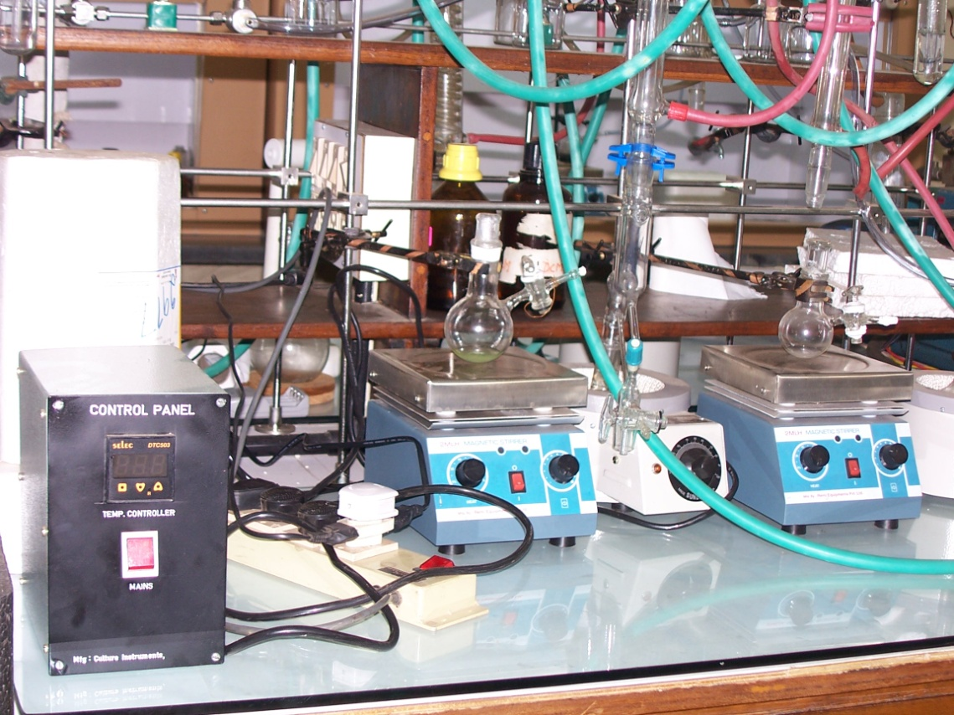
  Avoiding Electrical Fires
  Do not cascade extension boards

Slide 49
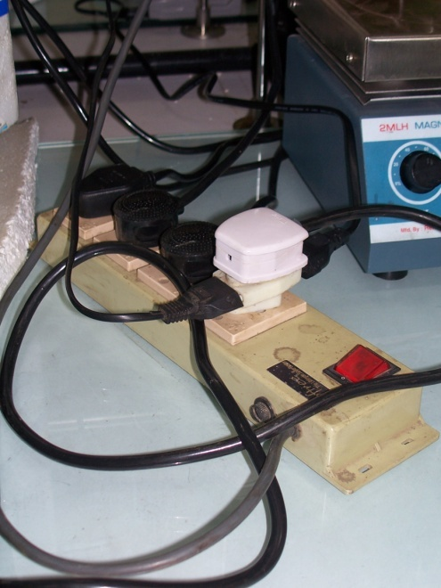
Electrical Safety
  Do not put multiple pins on the same socket.
  Check the earth to neutral voltage

Slide 50
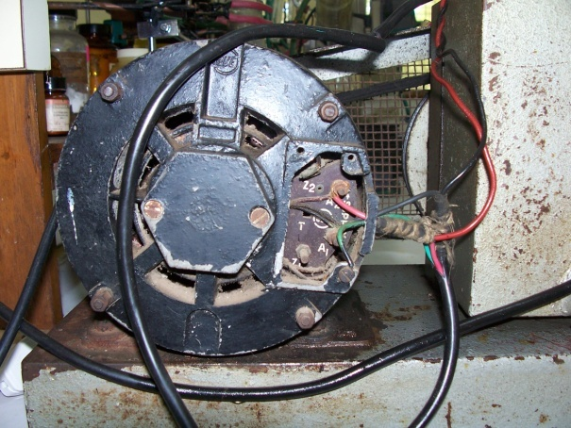
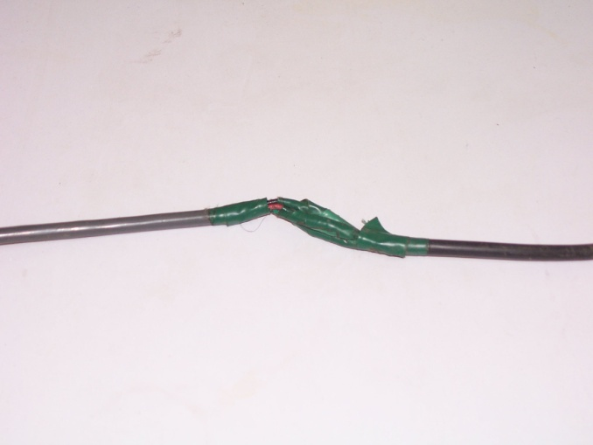
Do not defeat or “circumvent” safety locks in any instrument.
Do not work around exposed live conductors
Equipment
  Replace worn
  components
Notes:
A laboratory worker noticed condensation on the high voltage power supply for a high powered laser. With the power still on, he wiped the moisture with a tissue, making contact with the exposed anode terminal at approximately 17,000 volts DC to ground.
He received a severe electrical shock and second degree burns to his right thumb and abdomen. Witnesses stated that they heard a loud "snap" and then heard the laboratory worker scream and stagger out to the hallway. He was immediately met by a secretary, and told her "I got a shock" as he collapsed into her arms and onto the floor. He had no pulse and was not breathing. Public Safety officers were nearby and immediately started CPR. The ambulance crew arrived and was able to restore his heartbeat using a defibrillator.
Fortunately, the laboratory worker lived to tell his story. He said that he knew that the power was on but was not aware that contact was possible at the high voltage terminals.

Slide 51
  -Carbon dioxide extinguishers should be used around sensitive equipment.
  Dry powder extinguishers can damage such equipment.

Slide 52
Laboratory Waste
Purchase Prudently
Practice Solvent Recycling
Collect and Dispose waste properly
Maintain an Inventory
Use Less and Less and Less ...

Slide 53
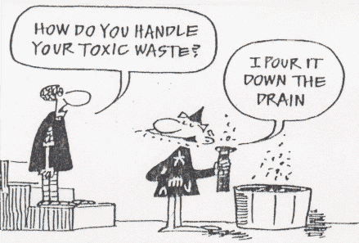

Until recently…...

Slide 54
Disposing of waste solvents
Chemical containers should be triple rinsed and dry
before being used for waste accumulation
Solvent waste cans are labeled properly with: Name, Contents, Lab #.

Slide 55
CHEMICAL WASTE CONTAINER
LABELING
Prepare a waste label before the containers are placed in the waste hood.
Each waste container must be labeled
with the complete contents of the
container and any known hazards.
When the contents are not known, the disposal procedures must assume that halogens and/or heavy metals may be present. This increases the
cost of disposal.
PLEASE USE THE CORRECT WASTE CONTAINERS
Notes:
There is a lable1 waste.doc in the url mentioned above.

Slide 56
SAMPLE WASTE CONTAINER LABELS
HALOGENATED WASTE
ιιιιιιιιιιιιιιιιιιιιιιιιιιιιιιιιιιιι
HALOGENATED WASTE
ιιιιιιιιιιιιιιιιιιιιιιιιιιιιιιιιιιιι
ιιιιιιιιι__________ιιιι_____
Indian Institute of Science Hazardous Waste
ιιιιιιιιιιιιιιιιιιιιιιιιιιιιιιιιιιιι
Generator/Contact _________ Date _______
Phone No ______Dept ______ Rm No _____
Chemical Name/Composition _____________
____________________________________
_______________________________
_____________________________________
IPC AGS
3-3-12
2384
Chem
IPC 123
dichloromethane
bromobenzene
The first label gives
the type of waste.
chlorocyclohexane
Check Hazard(s)
X
The second label
gives specifics:
Every chemical
needs to be listed
by name, and all
known hazards
must be specified.
Toxic
Corrosive
Oxidizer
Highly Toxic
Flammable
Solid
Acid
Water Reactive
X
Liquid
Base
Air Reactive
Gas
Other Hazard(s)
Handle With Care * Don’t Mix Waste *
_____________________
Specify ALL contents

Slide 57
CHEMICAL WASTE DISPOSAL
CONTAINERS
Waste containers are found in the
waste disposal hoods - one hood at
each end of the laboratory.
All wastes are collected in containers
located in the waste disposal hoods.
Several types of containers are supplied.
Liquid wastes or solutions fit into one of the following containers.
Halogenated Waste
Non-Halogenated Waste
Aqueous Waste
Heavy Metal Waste
Solids

Slide 58
Halogenated Waste
F
Br
Cl
I
Any chemical compound which contains any of a Group VII element compound.
Organic liquids (or liquid mixtures) which contain halogenated compounds should be placed in a separate waste container.
C H
N O
Non-Halogenated Waste
Organic liquids (or liquid mixtures) which
do not contain any halogens may be
placed in this container for disposal.
It costs more to process halogenated waste because
more rigorous (and costly) procedures are required to
prevent the formation of acidic gases (HCl, HBr, etc.)

Slide 59
Aqueous Waste
H₂O
Aqueous means it is contaminated water or a water solution containing inorganics. Any water based solutions (except those containing
heavy metals) should be placed in the aqueous waste
container.
Cr
Heavy Metal Waste
Hg
Pb
Heavy metals include the transition metals.
Typical heavy metals that might be used in an organic
lab might include Zn, Cr, Cu, Pb, Mn, Fe, Co, Ag, etc. Heavy metal wastes (although usually aqueous) should
be placed special containers designated for this purpose.

Slide 60
Zn
NaSO₄
Solid Chemical Wastes
Solid chemical wastes should be collected in
separate wide mouth containers, different from
the liquid containers.
Halogenated compounds and heavy metal solid
wastes should be separated.

Slide 61
Trash (Non-Hazardous Solid Wastes)
Paper, corks, tea leaves, and other non-hazardous
substances may be placed in the trash containers.
Do not, however, place any glass ( broken or not ) in
the trash containers.
Broken Glass Waste
Any glass or broken glass waste must be placed in the
special cardboard box containers provided.
Do not place paper or garbage in these containers.
Do not pick up broken glass with your fingers. Use a dust pan and broom located in a marked
cabinet.

Slide 62
Destroy before disposal
    - Alkyl boranes
    - Aluminum Alkynes
    - Ammonium Nitrate
    - Benzoyl Peroxide
    - Calcium Carbide
    - Chromic Acid
    - Cyanides
    - Ethers
    - Grignard Reagents
    - Hydrogen Peroxide
    - Iron Sulfide
    - Metal Alkyls
    - Metal Hydrides
    - Peracetic Acid Solution
    - Peroxide Forming Compounds
    - Picric Acid
    - Sulfides
    - Water reactive metals (Lithium, Potassium, Sodium, Cesium)

Slide 63
UNKNOWN WASTES
Identify the contents by asking other researchers if they produced the material or know who did.
If the original researcher cannot be found, ...contact the group leader.
If your efforts at identifying the waste are unsuccessful, the contents will have to be disposed at a significant cost!
Notes:
Costs a lot of money and time and is dangerous to dispose off

Slide 64
AVOID CONTAMINATION OF CHEMICALS
Do not put chemicals back into reagent bottles.
-Very important !
Returning an unused chemical to a container leads to contamination. Take only the amount you need.
Extra material must be placed in the appropriate chemical waste container !
Notes:
Not worth the risk.

Slide 65
We need special TRASH CONTAINERS
Trash containers are to be located
under the sinks on either side.
(positions may be reversed).
.
BROKEN
GLASS
TRASH
cylindrical
metal / plastic
container
cardboard
box
Not All Trash
is the Same
Broken glass can be recycled but difficult to carry
must be separated from other types of trash.

Slide 66
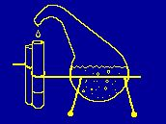
Working in the Laboratory..
Forbidden: Smoking, eating and drinking in the laboratory.
No food to be stored in chemical refrigerators.
All work and No play zone!
NEVER ALONE!!!!
NEVER work when you are tired
(or overwork ☺ ☺)

Slide 67
WHEN CAN YOU WORK ?
For your own safety, you should never work alone in the laboratory.
If you are injured there will be no one to help you or to call for emergency help.
YOU SHOULD NEVER WORK ALONE IN THE LAB
Do not work if you are drowsy or if you are taking medication.
Don't rush, Plan your work.

Slide 68
Prudent Practices..
Forbidden: Working alone in any laboratory and working without informing the guide / mentor that you are carrying out a new reaction.

Slide 69
Do your experiments in the hood.
Hood Sinks. The sinks in the hoods are meant to receive the water flow from condensers. Do not pour any chemicals or solutions down these sinks.
Excess chemicals go in waste containers.
Only water is placed in the hood
or bench sinks.
3/30/2012
69

Slide 70
Proper Attire
Everyone in the lab should use appropriate eye protection at all times -- in a laboratories and areas where chemicals are transported.
Have Personal Protective Equipment -- safety glasses, goggles, face shields, gloves, lab coats, and bench top shields.

Slide 71
PERSONAL PROTECTION
The most common type of exposure in the lab is the
inhalation of chemical vapors.
To protect yourself from vapors, always work with
chemicals in a hood.
The second most common type of exposure is to the eyes and skin.
Always wear goggles to protect your eyes.
Chemically resistant gloves will protect you from the most common type of skin exposure.
3/30/2012
71

Slide 72
EYEGLASSES
Ordinary eye glasses
(even if hardened) do not provide adequate protection to your eyes.
If you wear glasses, the goggles will fit over them.
CONTACT LENSES
Contact lenses ARE DANGEROUS!!
may be worn in the laboratory, but
you must also wear approved safety goggles.
Notes:
Safety glasses must be work at all times in the laboratory no matter where you work. If you wear prescription lenses, it is strongly recommended that you choose good quality plastic lenses since they are shatterproof. If the lenes are small, you must put on safety glasses on top of your prescription lenses whenever you are handling dangerous chemicals. Some common safety glasses are made from polycarbonates, which gradually become hazy specially when exposed to solvents and other chemicals. In such a situation the safety glasses must be replaced.

Slide 73
GOGGLES
GOGGLES MUST BE WORN AT ALL TIMES WHEN WORKING IN THE LABORATORY.
You must wear the type of goggles that seal completely
around the eyes and provide splash protection from top,
bottom, and the sides, as well as from the front.

Slide 74
Eye Protection
At University of X, an investigator was blinded in one eye when a cryotube exploded while being thawed.
The probable cause was the rapid expansion of liquid nitrogen that had entered the tube through a small crack during storage

Slide 75
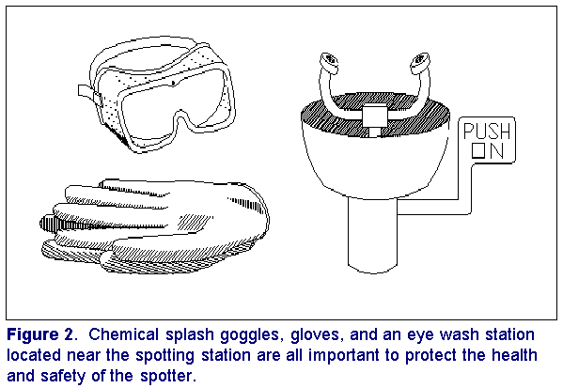
Eye Protection
Notes:
The eye wash has been installed in key places.
Or use hand held washing bottles. Wash for a long time

Slide 76
SHOES
You must wear closed-toe shoes in the laboratory
- open-toed sandals are not permitted.
- bare feet are not permitted

Slide 77
GLOVES
You are advised to use
chemically-resistant gloves for use
in the laboratory.
The most effective gloves for general use are the “nitrile” gloves.
LABORATORY COATS
If you wish you may also purchase a white lab coat, or an apron, to protect you from chemical spills.

Slide 78
TOXICITY
NO EATING OR DRINKING IS ALLOWED
IN THE LABORATORY
Do not bring any food or drink
into the lab, there is always a
risk of contamination with toxic
chemicals.
Notes:
This is especially true if you are doing experiments involving carcinogens.

Slide 79
It is not considered safe to drink water from any source in the laboratory.
Be sure you wash your hands well before going out before eating or drinking, your hands may be contaminated with chemicals.

Slide 80
Think before you carry out a reaction
What are the possible hazards?
What are the worst possible things that could go wrong?
How will I deal with them?
What are the prudent practices, protective facilities and equipment necessary to minimize the risk of exposure to the hazards?
Review Risk Assessment when scaling up reactions
Notes:
When you have to do a new reaction. you have to ask yourself or the guide the questions listed above.

Slide 81
Key Points
Don't leave reactions unattended.
Use proper PPE.
Set chemical hood sash to lowest height possible.
Ensure adequate ventilation
Notes:
After isolating the organic azide from a 1:1 solution of acetone and methylene chloride in the Buchi rotary evaporator, she lifted the 250 ml round bottom flask containing the organic azide from a water bath, with the handle provided for this purpose, using her left hand, while her right reached out for the flask.
The flask exploded in her hand, shattering all of the glass associated with the rotary evaporator and glass containers close by on the lab bench. Parts of the condenser were found in a hallway approximately 15 feet away.
Her recollection of the incident and the nature of her injuries, indicate that she did not have the opportunity to break the vacuum on the system or stop the rotation of the flask. It is believed that the raising of the flask alone from the warm water bath initiated the decomposition of the shock sensitive organic azide, perhaps by creating a movement in a contaminated ground glass joint. However, the graduate student does not feel that solvent "bumping" occurred in this case. This could have caused the azide compound to contaminate the glass joints.
Injuries and property damage caused by the incident: The glass fragments from the exploding flask severely lacerated the graduate student's right hand and cut her cheek and forehead. The force of the explosion blew her to the floor where she lay stunned and bleeding. The safety glasses she was wearing protected her eyes from glass fragments; otherwise she may have been blinded. The two students with her immediately came to her aid and called an ambulance that transported her to the hospital five minutes away. That night a four-hour surgical operation removed the glass from her face and hand and subsequent surgery restored most, but not all, of the functionality of her hand. She lost the ability to move her thumb. She also underwent multiple plastic surgery operations to improved her appearance.

Slide 82
And when it happens...
All accidents (incidents) must be reported, evaluated by the departmental safety committee, and discussed at departmental safety meetings.

Slide 83

FIRE
There will be a complete lecture on fire safety and first-aid.
13thApril 2012
-If clothing is on fire, smother the flame by rolling on the ground or use a safety shower to extinguish the fire.
From http://ilpi.com/safety/extinguishers.html
Notes:
The link has a presentation on fire hazards.

Slide 84
Acknowledgements
This Material has been liberally borrowed from the internet.
SOURCE:…All the pages that come on a Google Search for Chemical Safety
Thanks to the many, many people out there who prepared this…

Slide 85
We wish you all a safe
working environment!!

